Slide 1
Lecture 16

Slide 3
Lens
Image
Light Source

Slide 5
Fish out of water
Rays from fish head
Eyes
d_{o}
Rays from fish tail

Slide 6
Fish out of water
Rays from fish
Eyes
d_{o}
Rays from fish
Fish in water
Image of Fish
Rays appear to come from here
d_{i}

Slide 7
d_{o}
d_{i}
Rays from fish
Fish in water
ℓ
Image of Fish
θ₂
θ₁
ℓ
θ₁
θ₂
Rays appear to come from here
n₁ (Large)
n₂ (Small)

Slide 8
Question 223.15.4
What type of lens is a simple magnifier?
Convex
Concave
Diverging
Converging
More than one of the above

Slide 9
Question 223.15.6
A
f
f
f
f
B
f
f
A ray enters a lens as shown above. Which of the choices to the right shows how the ray will exit the lens?
C
f
f

Slide 10
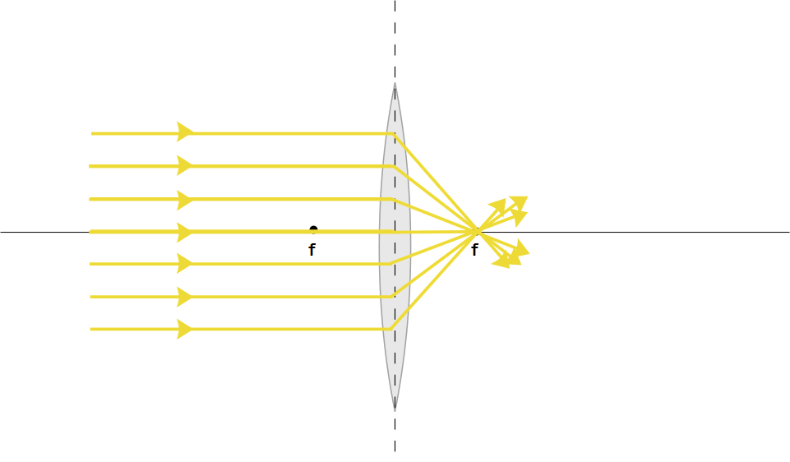

Slide 11
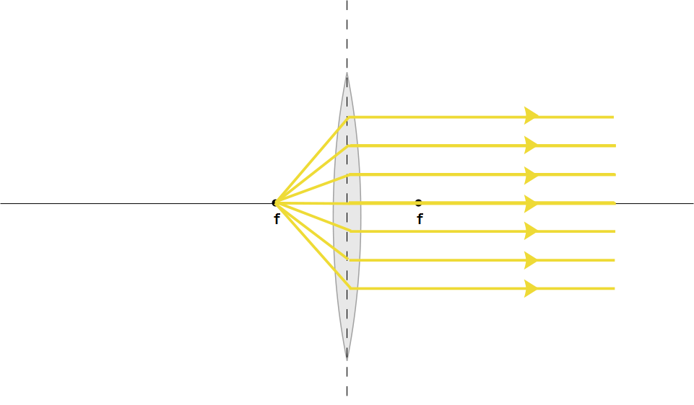

Slide 13
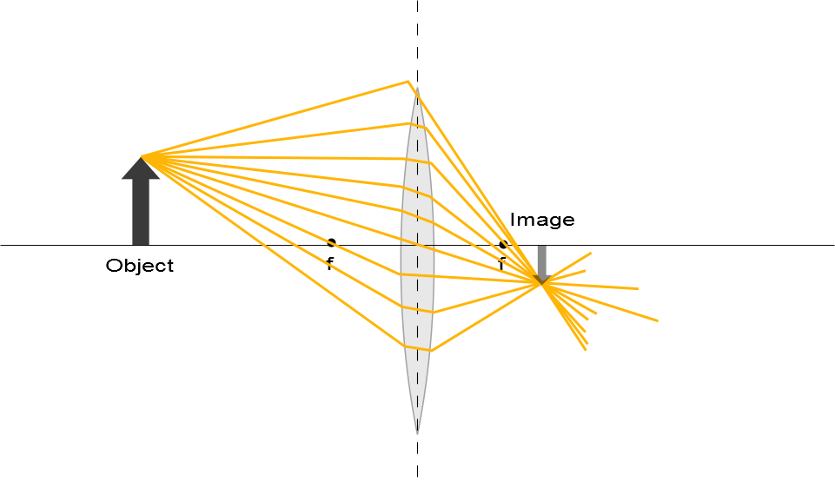

Slide 14
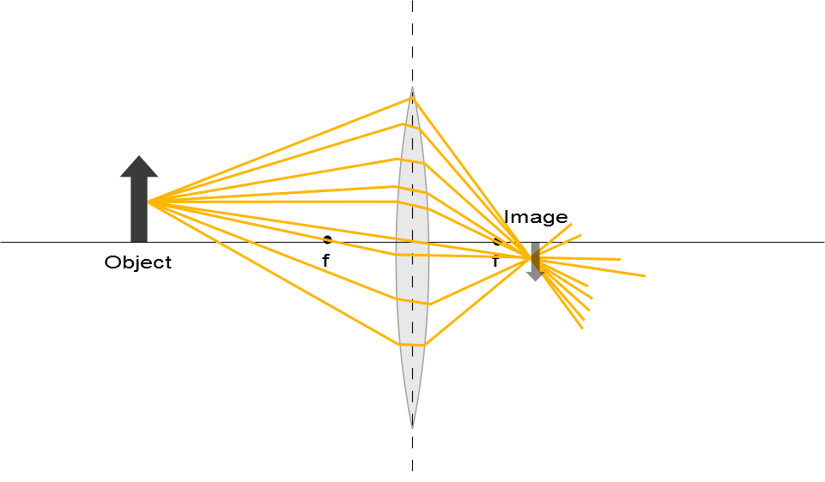

Slide 15
d_{o}
d_{i}

Slide 16
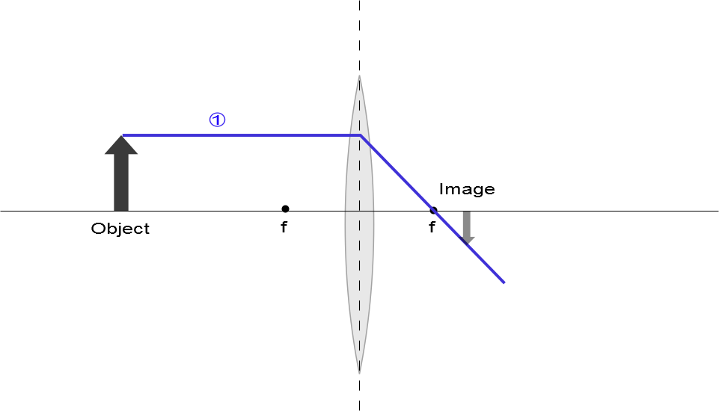

Slide 17
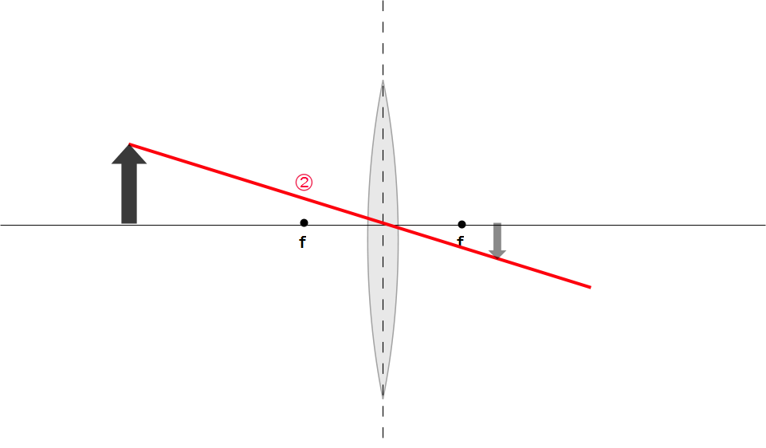
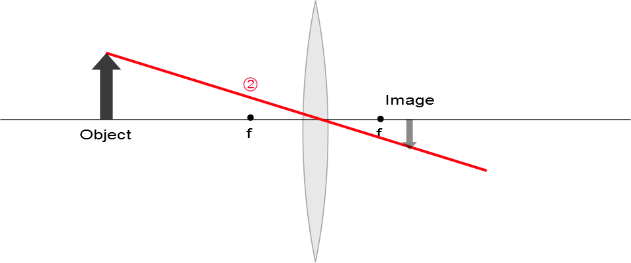

Slide 18
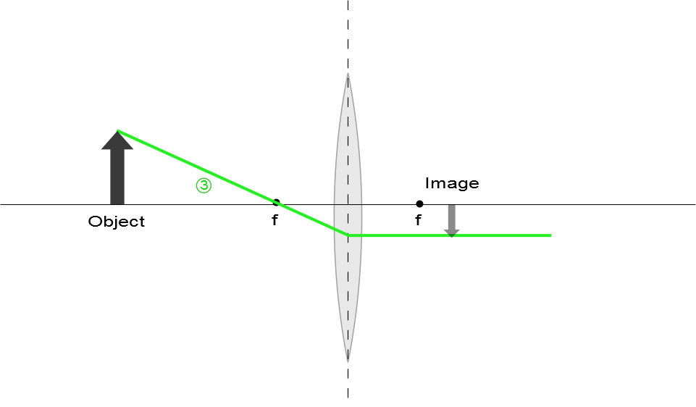

Slide 19
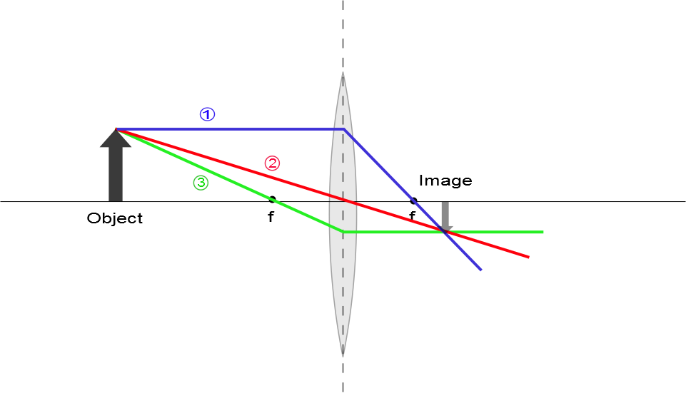
Ray Diagram for Converging Lens, s > f
The image is real
The image is inverted
The image is on the back side of the lens

Slide 20
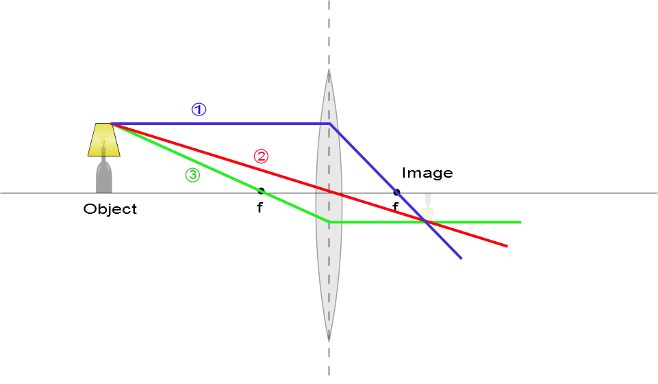
Ray Diagram for Converging Lens, s > f
The image is real
The image is inverted
The image is on the back side of the lens

Slide 21
Question 223.15.7
A
f
f
f
f
B
f
f
A ray enters a lens as shown above. Which of the choices to the right shows how the ray will exit the lens?
C
f
f

Slide 22
Question 223.15.8
A
f
f
f
f
B
f
f
A ray enters a lens as shown above. Which of the choices to the right shows how the ray will exit the lens?
C
f
f

Slide 23
Question 223.15.9
A
f
f
f
f
B
f
f
A ray enters a lens as shown above. Which of the choices to the right shows how the ray will exit the lens?
C
f
f

Slide 24
Question 223.15.10
A
f
f
f
f
B
f
f
A ray enters a lens as shown above. Which of the choices to the right shows how the ray will exit the lens?
C
f
f

Slide 25
Question 223.15.11
A
f
f
f
f
B
f
f
A ray enters a lens as shown above. Which of the choices to the right shows how the ray will exit the lens?
C
f
f

Slide 26
Question 223.15.12
A
f
f
f
f
B
f
f
A ray enters a lens as shown above. Which of the choices to the right shows how the ray will exit the lens?
C
f
f

Slide 27
Question 223.15.13
A
f
f
f
f
B
f
f
A ray enters a lens as shown above. Which of the choices to the right shows how the ray will exit the lens?
C
f
f

Slide 28
Question 223.15.13
A
f
f
f
f
B
f
f
A ray enters a lens as shown above. Which of the choices to the right shows how the ray will exit the lens?
C
f
f

Slide 29
Question 223.15.14
Three rays leave a glowing object and pass through a lens as shown. After passing through the lens, where do they meet?
At f
At the center of the lens
This is silly, they don’t meet anywhere
f
f

Slide 30
Question 223.15.15
Three rays leave a glowing object and pass through a lens as shown. After passing through the lens, where does our brain think they meet?
At f
At the center of the lens
Somewhere behind the lens off to the left
f
f

Slide 31
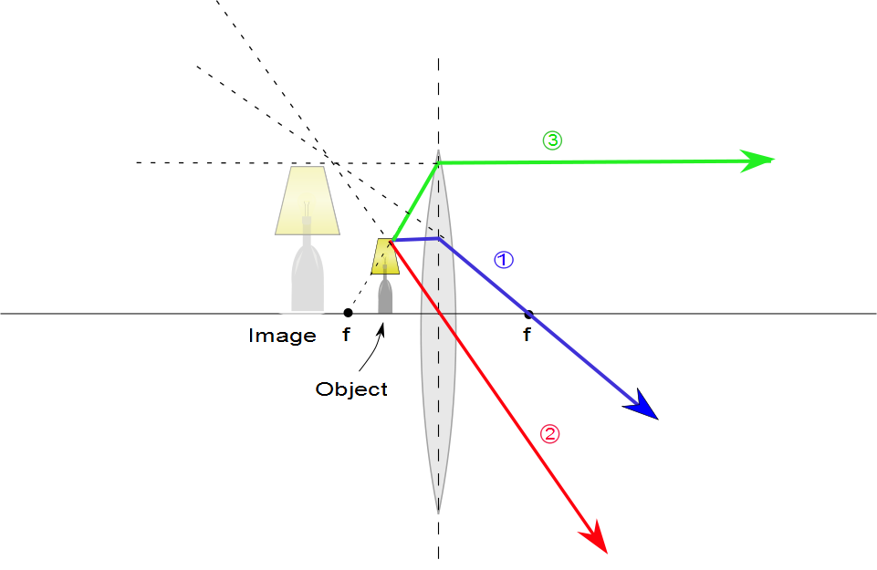
Ray Diagram for Converging Lens, p < f
The image is virtual
The image is upright
The image is larger than the object
The image is on the front side of the lens

Slide 32
Ray Diagrams for Thin Lenses – Diverging
For a diverging lens, the following three rays are drawn:
Ray 1 is drawn parallel to the principal axis and emerges directed away from the focal point on the front side of the lens
Ray 2 is drawn through the center of the lens and continues in a straight line
Ray 3 is drawn in the direction toward the focal point on the back side of the lens and emerges from the lens parallel to the principal axis

Slide 33
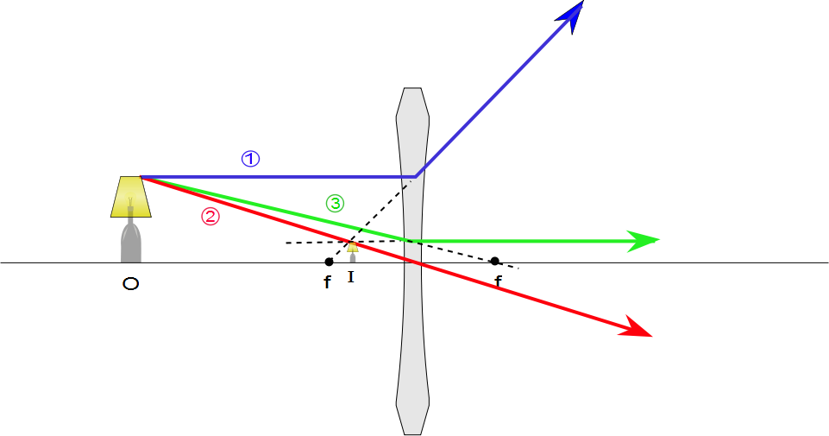
Ray Diagram for Diverging Lens
The image is virtual
The image is upright
The image is smaller
The image is on the front side of the lens

Slide 34
Question 223.16.1
What is the focal length of a pane of window glass?
zero
infinity
the thickness of the glass
impossible to determine

Slide 35
Derivation of the Lens Equ.
B
A
C₁
C₂
P
S
n
t
R₂
d_{o1}
d_{i2}
R₁

Slide 36
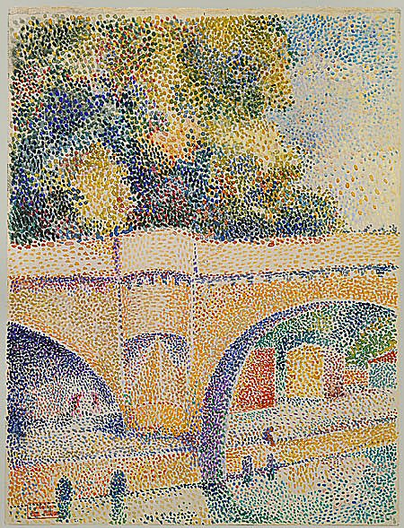

Slide 37
Derivation of the Lens Equ.
B
A
C₁
C₂
P
S
n
t
R₂
d_{o1}
d_{i2}
R₁

Slide 38
Derivation of the Lens Equ.
A
P₁
C₁
S
n
d_{i1}
d_{o1}
R₁

Slide 39
Derivation of the Lens Equ.
B
A
A
C₁
P₁
C₁
C₂
P₂
S
n
R₂
d_{i1}
d_{i2}
t
d_{o2}

Slide 40
Derivation of the Lens Equ.
B
A
C₁
C₂
P
S
n
t
R₂
d₀₁
d_{i2}
R₁

Slide 41
Derivation of the Lens Equ.
R₁
S
C₂
n
C₁
P
R₂
d_{o1}
d_{i2}

Slide 42
Derivation of the Lens Equ.
R₁
S
C₂
n
C₁
P
R₂
d_{o}
d_{i}

Slide 43
P₃
P₂
P₁
S₁
S₂
S₃
d_{o}
d_{i}

Slide 44
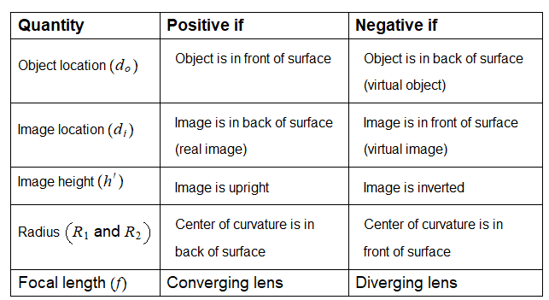

Slide 45
Question 223.16.2
If the image is on the same side of the air-glass interface as the object, we call this a virtual image. What would be the sign of the image distance, s’?
Positive
Negative
Neutral

Slide 46
Question 223.16.3
If the image inverted, what is the sign of the image height?
Positive
Negative
Neutral

Slide 47
Question 223.16.4
If the image is inverted, what is the sign of the magnification?
Positive
Negative
Neutral

Slide 48
Question 223.16.5
What would
Be for a thin lens?
The radius ratio
The lens thickness
The lens width
The focal length

Slide 49
Question 223.16.6
The professor tells us that we will find the thin lens formula by making the image of a dot of light. This is OK because…
No one takes pictures of anything but dot’s of light
He is lazy and does not want to do anything bigger than a dot
A dot of light images into a complete picture, like the Mona Lisa
We can think about any extended body as consisting of emitting or reflecting dots.

Slide 50
Derivation of the Lens Equ.
Front
Back
R₁
S
C₂
n
C₁
P
R₂
d_{o1}
d_{i2}

Slide 51
h_{o}
θ
I
O
n
θ
h_{i}
d_{o}
d_{i}

Slide 52
Question 223.15.3
You are building a camera with refractive lenses. Would you expect all colors of light to focus at the same point?
Yes
No
Can’t tell

Slide 53
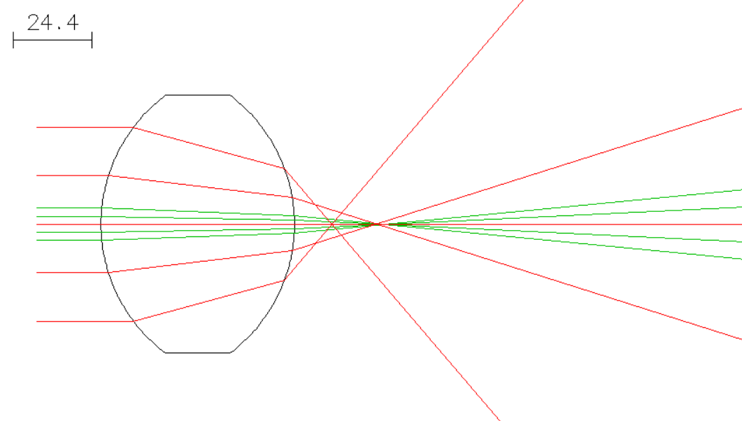

Slide 54
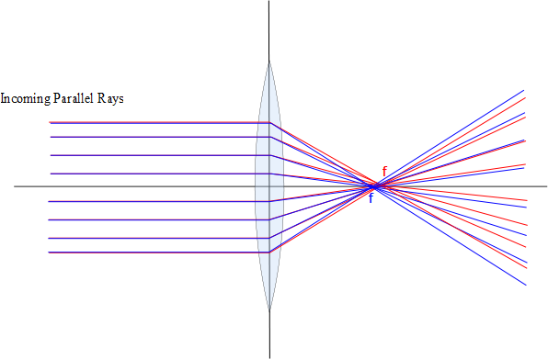

Slide 55
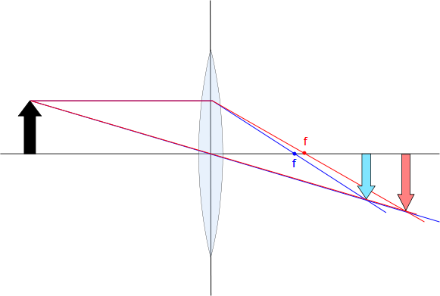

Slide 56
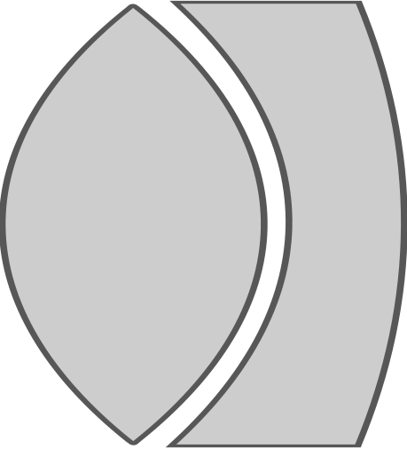


Slide 57
END

Slide 58
Question 223.18.1
Two campers wish to start a fire during the day. One camper is nearsighted and one is farsighted. Whose glasses should be used to focus the Sun’s rays onto some paper to start the fire?
either camper
the nearsighted camper
the farsighted camper

Slide 59
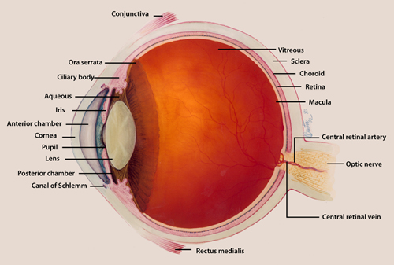

Slide 61
Question 223.18.2
What do biologists call the process of focusing the light in the eye?
focusing
accommodation
image formation
Contraction of the ciliary muscle

Slide 62
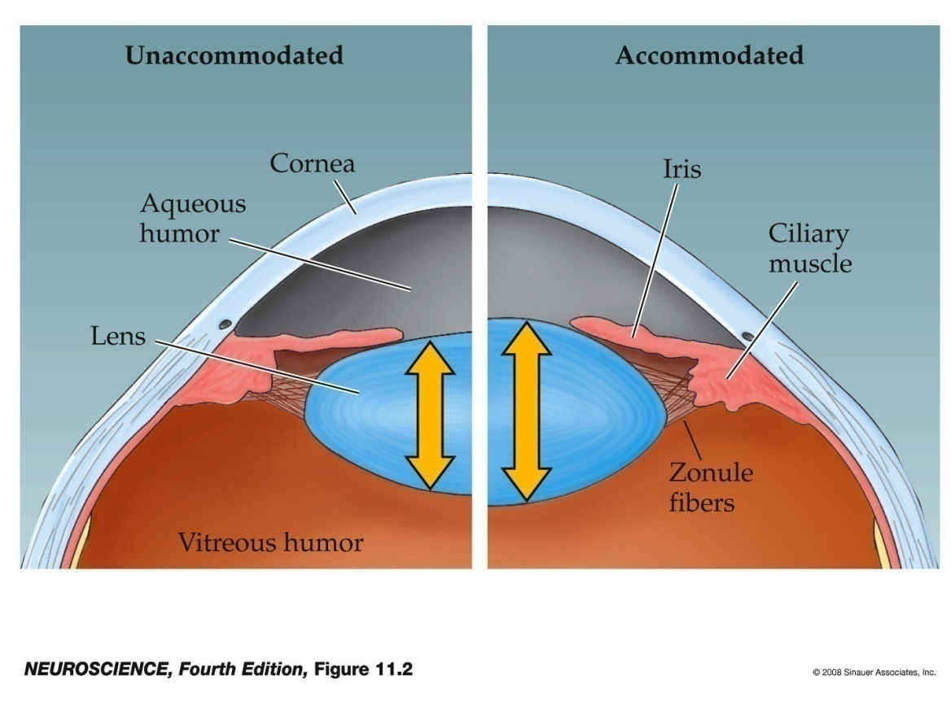
Accommodation by the Lens
Accommodation refers to dynamic changes in the shape of the lens.
As an object comes within about 20 feet the light rays originating at a point are no longer considered to be parallel.
Rather these light rays diverge and a greater refractive power is required to bring them into focus.
The lens can contribute about 12 or more diopters to the focusing of light rays on the back of the eye by rounding up.
Notes:
neuro4e-fig-11-02-0.jpg

Slide 63
Question 223.18.3
What do we call the position of the closest thing we can see?
Near point
Far point
Squint point
conjunctiva

Slide 64
Normal
Myopia – nearsightedness
Hyperopia - farsightedness

Slide 65
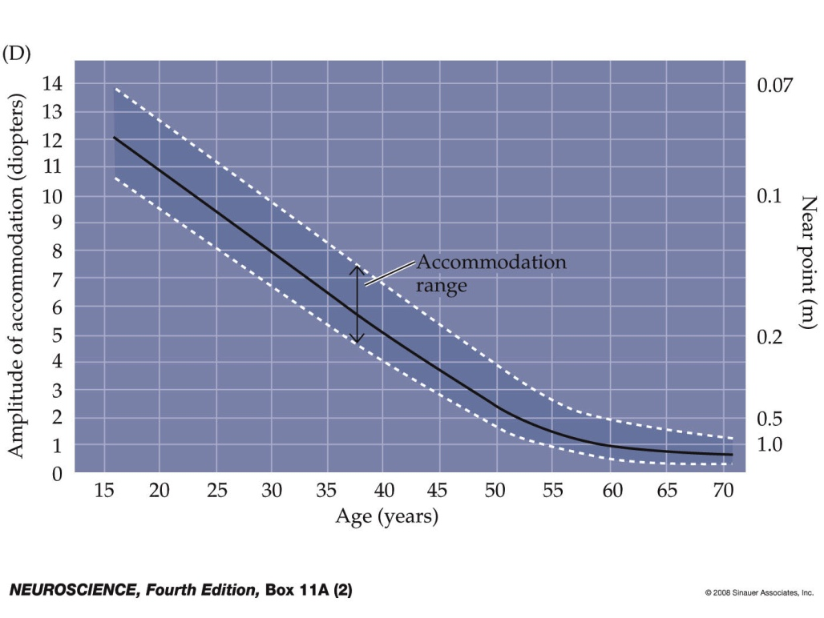
Notes:
neuro4e-box-11-a(2)-0.jpg

Slide 66
Question 223.18.4
What is the power (in Diopters) of a lens with a focal distance of 0.5m?
5
4
3
2
1

Slide 67
532THz (red)
562THz (green)
714THz (blue)
Relative Sensitivity
Frequency

Slide 68
Relative Sensitivity
(red)
(green)
(blue)
Frequency

Slide 69
Question 223.16.7
Diving masks often have a lens built into the glass for divers who do not have perfect vision. This allows the individual to dive without the necessity for glasses, because the lenses in the faceplate perform the necessary refraction to provide clear vision. The proper design allows the diver to see clearly with the mask on both under water and in the open air. Normal eyeglasses have lenses that are curved on both the front and rear surfaces. The lenses in a diving mask should be curved
only on the front surface
only on the rear surface
on both the front and rear surfaces

Slide 70
Question 223.16.8
Consider a flat mirror. Which of the following is true?
The image is as far behind the mirror as the object is in front
The image is twice as far away as the object is from the mirror
The image is farther away, but you would need to know the particular circumstances to know how far.
The image is in the same place as the object.

Slide 71
Question 223.16.9
What is the magnification of a flat mirror
1
2
-1
½
The image is unmagnified

Slide 72
Question 223.16.10
When you look in a flat mirror you observe
Left right reversal
Top bottom reversal
Front back reversal
No reversal

Slide 73
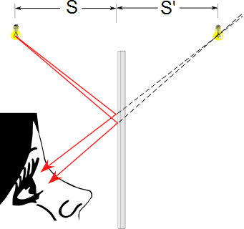
Flat Mirrors
Simplest possible mirror
Light rays leave the source and are reflected from the mirror
Point I is called the image of the object at point O
The image is virtual
O
I

Slide 74
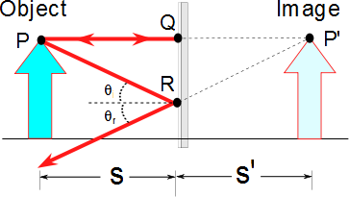
Flat Mirrors
One ray starts at point P, travels to Q and reflects back on itself
Another ray follows the path PR and reflects according to the law of reflection

Slide 75
Images Formed by Flat Mirrors, 4
To observe the image, the observer would trace back the two reflected rays to P’
Point P’ is the point where the rays appear to have originated
The image formed by an object placed in front of a flat mirror is as far behind the mirror as the object is in front of the mirror
|s| = |s’|

Slide 76
Lateral Magnification
Lateral magnification, M, is defined as
This is the general magnification for any type of mirror
It is also valid for images formed by lenses
Magnification does not always mean bigger, the size can either increase or decrease
M can be less than or greater than 1

Slide 77
Lateral Magnification of a Flat Mirror
The lateral magnification of a flat mirror is 1
This means that h’ = h for all images

Slide 78
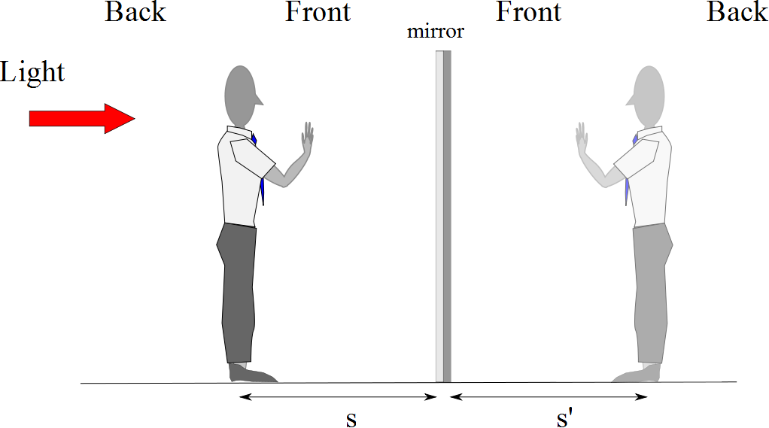
Reversals in a Flat Mirror

Slide 79
Reversals in a Flat Mirror

Slide 81
Question 223.26.4.6
Suppose I have a spherical mirror and I tell you that s is positive and s’ is negative. What type of mirror might I have
Concave
Convex
Can’t tell

Slide 82
Question 223.16.11
I have a concave mirror. If I place an object closer than the focal distance, the image is
Inverted and has a magnification greater than 1
Not inverted and has a magnification greater than 1
Inverted and has a magnification smaller than 1
Not inverted and has a magnification smaller than 1

Slide 83
Question 223.16.12
Will a refractive spherical optic display spherical aberration?
Yes
No
Sometimes yes, sometimes no

Slide 84
Question 223.15.8
A
C
f
C
f
B
C
f
A ray enters a mirror as shown above. Which of the choices to the right shows how the ray will exit the mirror?
C
C
f

Slide 85
Question 223.15.8
A
C
f
C
f
B
C
f
A ray enters a mirror as shown above. Which of the choices to the right shows how the ray will exit the mirror?
C
C
f

Slide 86
Question 223.15.8
A
C
f
C
f
B
C
f
A ray enters a mirror as shown above. Which of the choices to the right shows how the ray will exit the mirror?
C
C
f

Slide 89
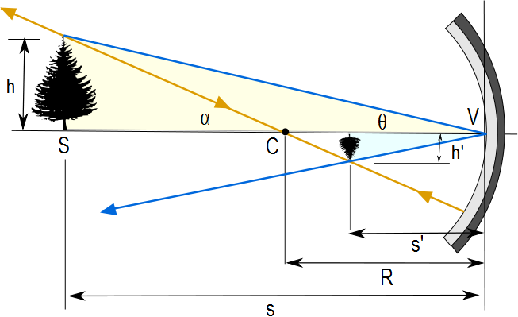
Image Formed by a Concave Mirror
Geometry can be used to determine the magnification of the image
h_{i} is negative when the image is inverted with respect to the object

Slide 90
Concave Mirror, Notation
The mirror has a radius of curvature of R
Its center of curvature is the point C
Point V is the center of the spherical segment
A line drawn from C to V is called the principal axis of the mirror

Slide 92
Paraxial Rays
We use only rays that diverge from the object and make a small angle with the principal axis
Such rays are called paraxial rays
All paraxial rays reflect through the image point

Slide 93
Spherical Aberration
Rays that are far from the principal axis converge to other points on the principal axis
This produces a blurred image
The effect is called spherical aberration

Slide 94
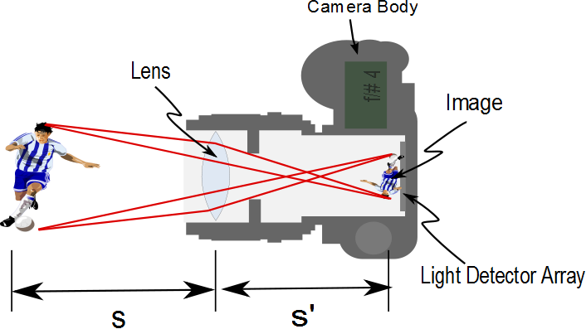

Slide 95
Image Formed by a Concave Mirror
Geometry also shows the relationship between the image and object distances
This is called the mirror equation
If p is much greater than R, then the image point is half-way between the center of curvature and the center point of the mirror
s → ∞ , then 1/ s ≈ 0 and s’ ≈ R/2

Slide 96
Focal Length
When the object is very far away, then s→ ∞ and the incoming rays are essentially parallel
In this special case, the image point is called the focal point
The distance from the mirror to the focal point is called the focal length
The focal length is ½ the radius of curvature

Slide 97
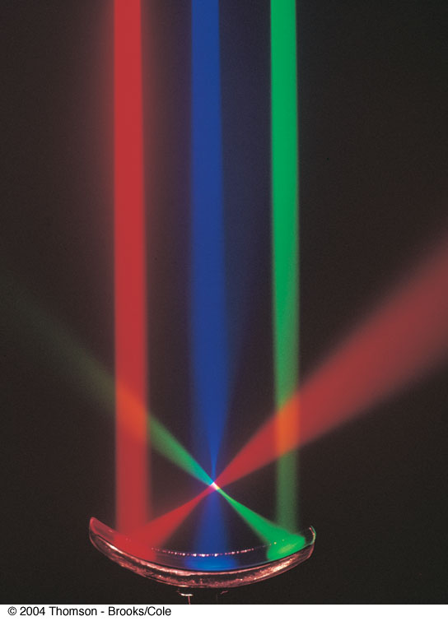
Focal Point, cont.
The colored beams are traveling parallel to the principal axis
The mirror reflects all three beams to the focal point
The focal point is where all the beams intersect
It is the white point

Slide 98
Focal Point and Focal Length, cont.
The focal point is dependent solely on the curvature of the mirror, not on the location of the object
It also does not depend on the material from which the mirror is made
ƒ = R / 2
The mirror equation can be expressed as

Slide 99
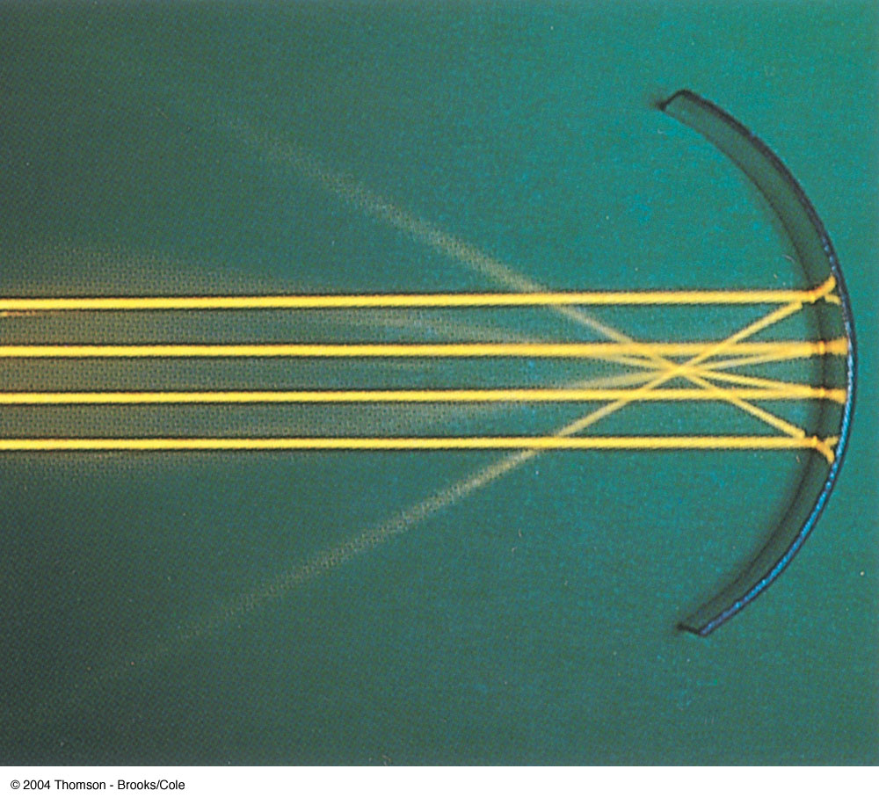
Focal Length Shown by Parallel Rays

Slide 100
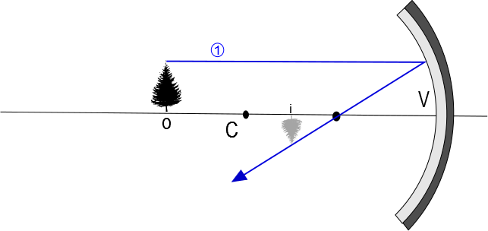

Slide 101
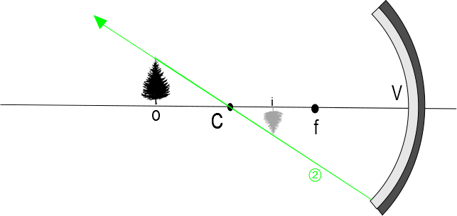

Slide 102
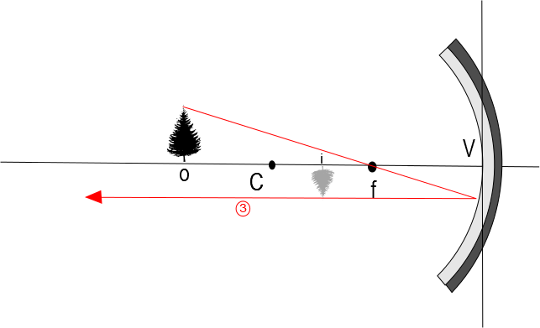

Slide 103
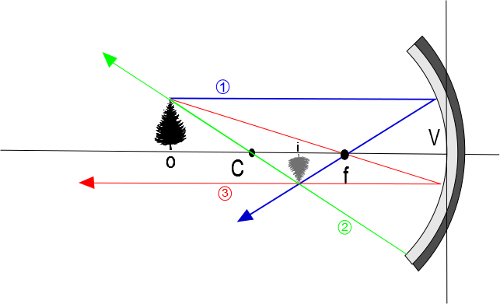

Slide 104
Convex Mirrors
A convex mirror is sometimes called a diverging mirror
The light reflects from the outer, convex side
The rays from any point on the object diverge after reflection as though they were coming from some point behind the mirror
The image is virtual because the reflected rays only appear to originate at the image point

Slide 105
Image Formed by a Convex Mirror
In general, the image formed by a convex mirror is upright, virtual, and smaller than the object

Slide 107
Front
Back

Slide 108
Ray Diagrams
A ray diagram can be used to determine the position and size of an image
They are graphical constructions which reveal the nature of the image
They can also be used to check the parameters calculated from the mirror and magnification equations

Slide 109
Drawing a Ray Diagram
To draw a ray diagram, you need to know:
The position of the object
The locations of the focal point and the center of curvature
Three rays are drawn
They all start from the same position on the object
The intersection of any two of the rays at a point locates the image
The third ray serves as a check of the construction

Slide 110
Ray Diagram – Concave Mirrors
Ray 1 is drawn from the top of the object parallel to the principal axis and is reflected through the focal point, F
Ray 2 is drawn from the top of the object through the focal point and is reflected parallel to the principal axis
Ray 3 is drawn through the center of curvature, C, and is reflected back on itself

Slide 111
Notes About the Rays
The rays actually go in all directions from the object
The three rays were chosen for their ease of construction
The image point obtained by the ray diagram must agree with the value of q calculated from the mirror equation

Slide 112
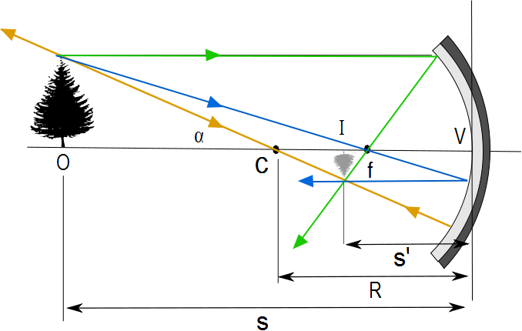
Ray Diagram for a Concave Mirror, s > R
The center of curvature is between the object and the concave mirror surface
The image is real
The image is inverted
The image is smaller than the object (reduced)

Slide 113
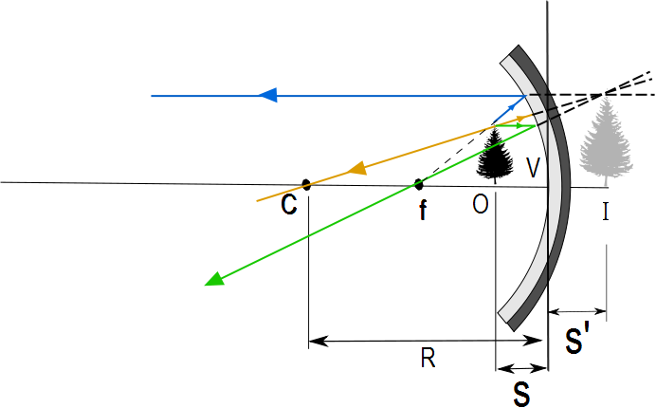
Ray Diagram for a Concave Mirror, s < f
The object is between the mirror surface and the focal point
The image is virtual
The image is upright
The image is larger than the object (enlarged)

Slide 114
The Rays in a Ray Diagram – Convex Mirrors
Ray 1 is drawn from the top of the object parallel to the principal axis and is reflected away from the focal point, F
Ray 2 is drawn from the top of the object toward the focal point and is reflected parallel to the principal axis
Ray 3 is drawn through the center of curvature, C, on the back side of the mirror and is reflected back on itself

Slide 115
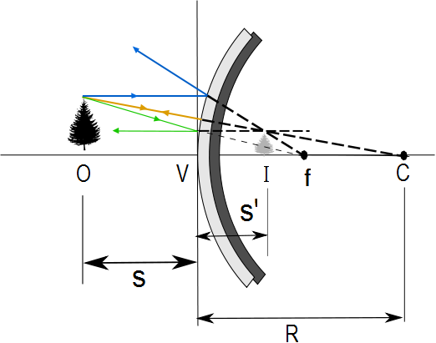
Ray Diagram for a Convex Mirror
The object is in front of a convex mirror
The image is virtual
The image is upright
The image is smaller than the object (reduced)

Slide 116
Notes on Images
With a concave mirror, the image may be either real or virtual
When the object is outside the focal point, the image is real
When the object is at the focal point, the image is infinitely far away
When the object is between the mirror and the focal point, the image is virtual
With a convex mirror, the image is always virtual and upright
As the object distance decreases, the virtual image increases in size

Slide 117
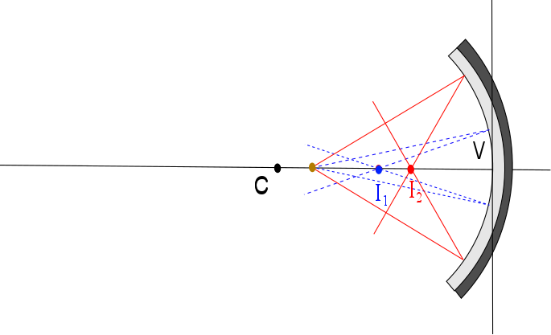

Slide 118
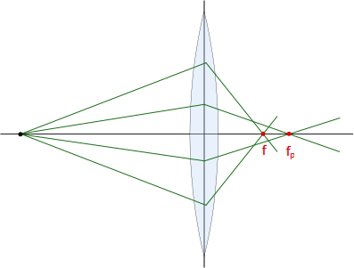

Slide 119
Question 223.17.1
I have two lenses placed next to each other to form an optical system. The focal length of the combined system is…..
25cm
f₁ +f₂
f₁ x f₂
No simple relationship

Slide 120
Question 223.17.2
I have two lenses placed right next to each other. The magnification of the combined system is…..
25cm
m₁ + m₂
m₁ x m₂
No simple relationship

Slide 121
Question 223.17.3
I have two lenses placed with a separation of 1m to form an optical system. The focal length of the combined system is…..
25cm
f₁ + f₂
f₁ x f₂
No simple relationship

Slide 122
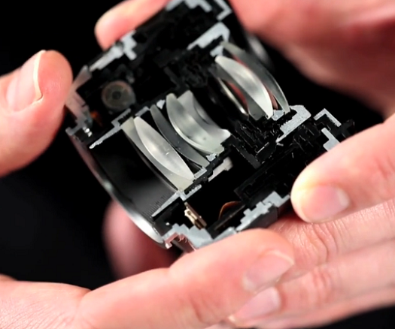
http://sonyalphanex.blogspot.com/

Slide 123
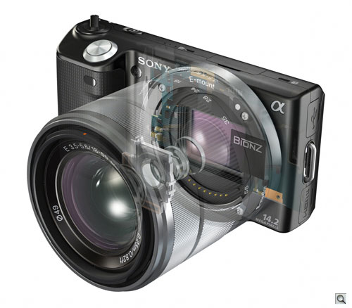
http://www.imaging-resource.com/PRODS/NEX5/NEX5A.HTM

Slide 124
I₁
O₂
f₁
f₂
O₁
f₁
f₂
I₂
s₁
s’₁
s₂
s’₂
d
f₁
f₂

Slide 125
Combination of Lenses
I₂
I₁ O₂
f₁
f₂
O₁
f₁
f₂
s₁
s’₁
s₂
d
f₁
f₂
s’₂

